Slide 1
PATHOLOGY OF BLOOD – I RBC & IT’S DISORDERS
R.M., SRSV

Slide 2
BLOOD
Blood transports oxygen and nutrients to body cells and removes carbon dioxide and other waste products from body cells for elimination.
The normal circulating blood volume in an adult 70kg man is 5600ml(8% of body wt.), among which about 55% is plasma & 45% is corpuscles.
Although the mature blood cells are quite different from each other in both structure and function, all of these cells develop from a common stem cell population, which resides in the bone marrow.
The developmental process is called haematopoiesis. More than 100 billion cells are produced every day. This makes the bone marrow one of the most active organs in the body.
Active marrow is called red bone marrow & inactive marrow which is infiltrated with fat is called yellow bone marrow.

Slide 3
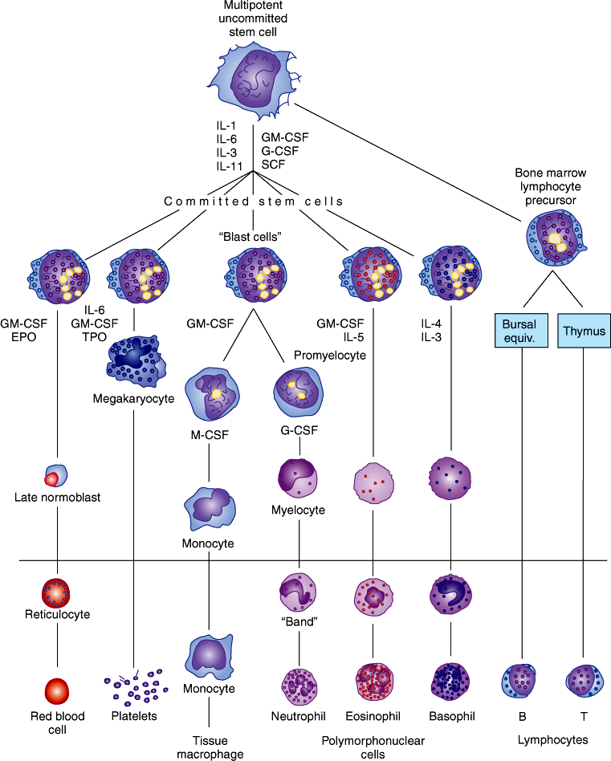
differentiation from stem cell to mature BLOOD CELLS

Slide 4
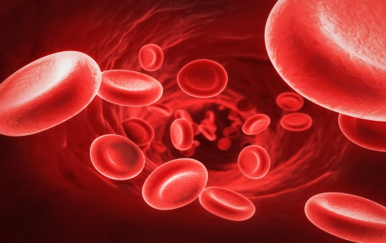
BLOOD
RBC: Erythrocytes are biconcave disc shaped cells, they lose nuclei before entering the circulation and contain haemoglobin to carry O2/CO2. Human RBC survive about 120 days, in circulation, it’s count is 5.4million cells/μL(MALE); 4.8 million cells/μL (FEMALE).
Each RBC is about 7.5μm in diameter, 2μm thick & contains 29pg of haemoglobin.
In an adult human about 3x10¹³RBC & about 900gm of haemoglobin present in circulation blood.

Slide 5
BLOOD
Anaemia: Anaemia is a condition that develops when your blood lacks enough healthy RBC or Hb. If we have too few or abnormal red blood cells, or our haemoglobin is abnormal or low, the cells in our body will not get enough oxygen.
Symptoms of anaemia: When anaemia comes on slowly the symptoms are often: feeling tired, weakness, shortness of breath or a poor ability to exercise. Anaemia that comes on quickly it may include: confusion, feeling like one is going to pass out, and an increased desire to drink fluids.

Slide 6
Etiologic classification of Anaemia:
1. Loss of blood: a) Acute post-haemorrhagic anaemia, b) Chronic post-haemorrhagic anaemia
2. Excessive destruction of RBC:
a) Extra corpuscular causes: i> Antibodies, Infection(malaria), ii> Splenic sequestration and destruction, iii> Drugs, chemicals and physical agents.
b) Intra-corpuscular causes: haemolytic disease
i. Genetic: Disorder of glycolysis, abnormalities in RBC membrane, Abnormalities in synthesis of globin.
ii. Acquired: lead poisoning etc.

Slide 7
Etiologic classification of Anaemia:
3. Impaired blood production: resulting from deficiency of substances essential for erythropoiesis :
a. Iron deficiency
b. Deficiency of vitamin B12 , folic acid and Protein deficiency.
4. Inadequate production of mature erythrocytes:
a) Deficiency of erythroblasts
b) Pure red cell aplasia
c) Infiltration of bone marrow- Leukaemia, lymphoma, Multiple myeloma
d) Endocrine abnormality- myxoedema
e) Chronic renal disease
f) Chronic inflammatory disease
g) Cirrhosis of liver

Slide 8
Anaemia owing to blood loss
Iron deficiency anaemia: Iron deficiency is defined as a reduction in total body iron to an extent that iron stores are fully exhausted and some degree of tissue iron deficiency is present. Females are mostly affected.
Etiology: Chronic blood loss, Inadequate dietary intake, Faulty iron absorption, Increased requirements for iron- infancy, childhood, pregnancy.
Clinical Manifestations: Chronic fatigue, Pallor of the conjunctiva, lips, and oral mucosa, Brittle nails with spooning, cracking, Splitting of nail beds, koilonychias, Palmar creases, Palpitations, Shortness of breath, numbness, Bone pain.
Oral Manifestations: Angular cheilitis, Glossitis with different degrees of atrophy of fungiform and filiform papillae, Pale oral mucosa, Oral candidiasis, Recurrent stomatitis, Erythematous mucositis, Burning mouth.

Slide 9
Anaemia owing to blood loss
Laboratory findings: Microcytic hypochromic anaemia due to inadequate supply of iron for normal haemoglobin synthesis.
RBC- 3,000,000-4,000,000/cubic mm, Low haemoglobin, Low serum iron and ferritin with an elevated total iron binding capacity (TIBC).
Plummer-Vinson Syndrome/ Paterson-Kelly syndrome:
Rare syndrome , middle-aged white women.
Classic triad: Dysphagia, Iron deficiency anaemia Upper oesophageal webs or strictures.
Etiopathogenesis: Unknown - iron deficiency, Malnutrition, Genetic predisposition and Autoimmune processes.
Treatment: Iron supplementation

Slide 10
BLOOD
Genetic anaemia: Abnormality in RBC production & maturation. Causes are- a) Abnormal erythropoiesis; b) inadequate haemoglobin formation; c) damages/changes affecting the RBC after leaving the bone marrow; d) attempts by the bone marrow to increase erythropoiesis to compensate anaemic condition.
Abnormality types:- 1. Membranopathy, 2. Haemoglobinopathy, 3. Fermentopathy.
Membranopathy:
These processes may abnormalities of RBC:
i> Anisocytosis: increased variation in size.
ii>poikilocytosis: increased variation in shape..
iii> Spherocytosis: more spheroidal shape than disc-like.
iv> Elliptocytosis: more oval or elliptical shaped cells present.

Slide 11
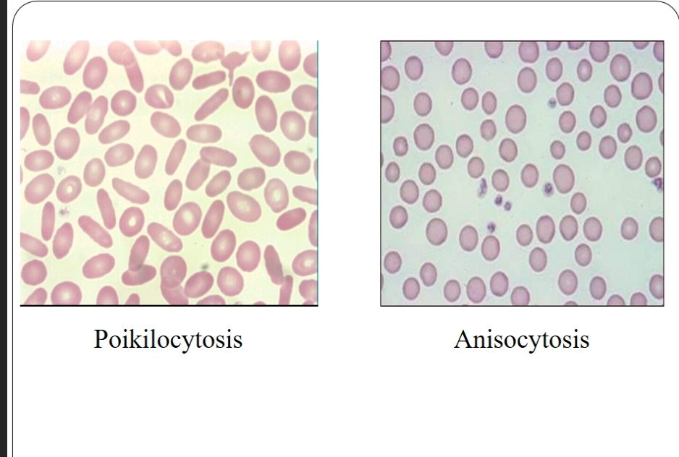
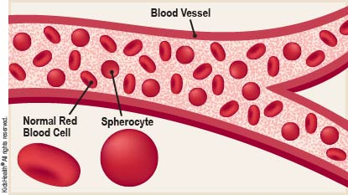
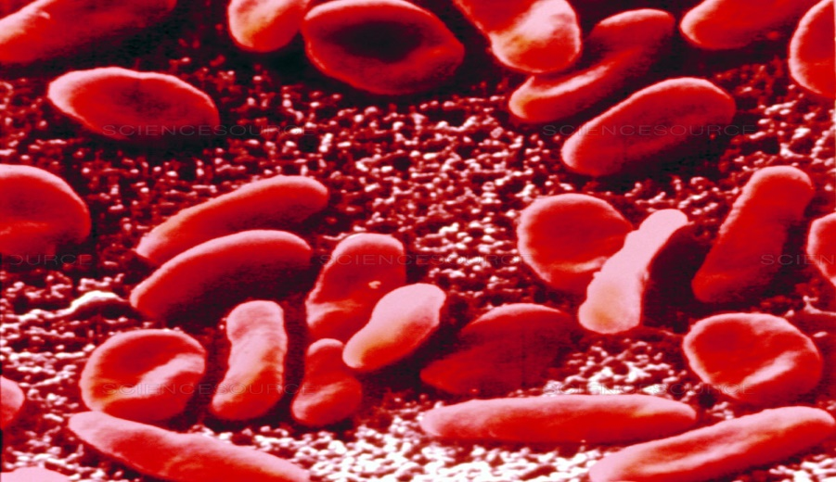
BLOOD
Spherocytosis Elliptocytosis

Slide 12
BLOOD
Haemoglobinopathy:
Haemoglobinopathy is a kind of genetic defect that results in abnormal structure of one of the globin chains of the haemoglobin molecule. Common Haemoglobinopathy include sickle-cell disease & thalassemia.
Inadequate haemoglobin formation:
i> Hypochromasia: A lower haemoglobin concentration. Which may results from, impaired haemoglobin synthesis, very common cause of iron deficiency or sideroblastic anaemia, a are cause of failure of globin synthesis as in thalassemia.
ii> Anisochromasia : In which a proportion only of the red cells stain palely, where anaemia patient responding to iron therapy or after the transfusion of normal blood to hypochromic or sideroblastic anaemic patient.
.

Slide 13
BLOOD
Fermentopathy:
This is the type of hereditary metabolic defect of individual patient.
Glycolysis: difficulty in glycolytic pathway due to pyruvate kinase deficiency.
Pentose phosphate shunt: difficulty in HMP shunt pathway due to G6PD enzymatic deficiency.
The glutathione system: Problem in glutathione reduction.

Slide 14
Sickle Cell Anaemia
Hereditary type of chronic haemolytic anaemia.
Erythrocytes have their normal biconcave discoid shape distorted, generally presenting a sickle-like shape. Reduces both their plasticity and lifetime from the normal 120 days average down to 14 days.
Clinical Manifestations: Common in females, before the age of 30 years, Cerebrovascular accidents/ strokes, Aplastic crises leading to severe anaemia, chronic leg ulcers, Haematuria, Aseptic osteonecrosis, Retinitis leading to blindness, Splenic sequestration, Renal failure, Acute chest syndrome - fever, cough, sputum production, dyspnoea, or hypoxia.

Slide 15
Sickle Cell Anaemia
Oral Manifestations: Significant bone change in dental radiograph, Mild to severe generalized osteoporosis , Loss of trabeculation of the jaw bone, Enamel hypo-mineralization, Pallor of the oral mucosa, Delayed eruption of the teeth, Pulpal necrosis Smooth tongue.
Laboratory findings: RBC- may reach a level of 1,000,000 cells per cubic mm., Decreased haemoglobin level, High reticulocyte count- Anaemia, Increased marrow response, Elevated lactic dehydrogenase and decreased levels of hepato globin- confirms haemolysis.
Blood smear: Typical sickle- shaped RBCs seen.

Slide 16
Erythroblastosis fetalis
Congenital haemolytic anaemia: due to Rh incompatibility results from the destruction of foetal-blood brought about by a reaction between maternal and foetal-blood factors.
Pathogenesis: EF is essentially due to inheritance by the foetus of a blood factor from the father that acts as a foreign antigen to the mother. Trans-placental transfer of this antigen, trans-placental leaks of RBC leads to, (from the foetus to the mother), Immunization of the mother, formation of antibodies which When transferred back to the foetus by the same route Produce fetal haemolysis.

Slide 17
Erythroblastosis fetalis
If both parents are homozygously Rh positive→ infant will be Rh positive → no maternal immunization, If mother is homozygously positive but father is Rh- negative → no maternal immunization, If father is Rh- positive and mother is Rh- negative → foetus inherits parental factor, which may act as an antigen to the mother and immunize her with resultant antibody formation.
Clinical features: Some infants are stillborn, Anaemia with pallor, Jaundice, Compensatory erythropoiesis.
Laboratory findings: RBC count decreased, large number of normoblasts or nucleated red cells, At present, Rh-negative mothers are being given anti-D gamma globulin to prevent immunization.

Slide 18
Thalassemia
Thalassemia is a group of genetic disorders of haemoglobin synthesis characterized by a disturbance of either alpha (α) or beta (β) haemoglobin chain production.
Pathogenesis: Normal adult haemoglobin (HbA)- haem is conjugated to globin. Globin- 2 pairs of α chain and β chain.
In thalassemia group of anaemias, Heterogeneous group- diminished synthesis of α chain and β chain of haemoglobin A.

Slide 19
Thalassemia
Thalassemia α- deficient synthesis of α chain.
Thalassemia β – deficient synthesis of β chain. - an excess of α- chains, producing ‘unstable haemoglobins’. Damage the erythrocytes → vulnerability to destruction.
In heterozygotes, the disease is mild and is called as Thalassemia minor, Represent both α and β thalassemia. In homozygote, severe form, called Thalassemia major or β – thalassemia. Production of β chain is markedly decreased or absent. Consequent decrease in synthesis of total haemoglobin occurs → severe hypochromic anaemia.

Slide 20
Anaemia Owing to Decreased Production of RBCs, Megaloblastic (Pernicious) Anaemia and Vitamin B12 (Cobalamin) Deficiency
It is adult form of anaemia that is associated with gastric atrophy and a loss of intrinsic factor production in gastric secretions. Rare congenital autosomal recessive form.
Autoimmune disease resulting from autoantibodies directed against intrinsic factor (a substance needed to absorb vitamin B12 from the gastrointestinal tract) and gastric parietal cells.
Vitamin B12 → erythrocyte – maturing factor.
Clinical Manifestations: Hematologic Megaloblastic (macrocytic) anaemia, Pancytopenia (leukopenia, thrombocytopenia), Neurologic Paresthesia, tingling and numbness of hands and feet. Peripheral neuropathy, Muscle weakness, Impaired sense of smell, Syncope Psychiatric, Fatigue Irritability, personality changes, Mild memory impairment, Depression, Cardiovascular increased risk of myocardial infarction and stroke.

Slide 21
Anaemia Owing to Decreased Production of RBCs, Megaloblastic (Pernicious) Anaemia and Vitamin B12 (Cobalamin) Deficiency
Oral Manifestations : Burning sensation in the tongue, lips, buccal mucosa, and other mucosal sites. The tongue is generally inflamed often described as ‘beefy-red’ in color. glossitis, recurrent attacks are common, Dysphagia and taste alterations have been reported.
Laboratory findings:
BLOOD: RBC count is seriously decreased, often to 1,000,000 or less per cubic mm.- Macrocytosis is one of the chief characteristic feature, although poikilocytosis or variation in shape of cells present. - pear or tear drop shape erythrocytes are present. - increased haemoglobin content. - mild to moderate thrombocytopenia is noticed.
SERUM: Indirect bilirubin may be elevated. serum lactic dehydrogenase is markedly increased. ↓- serum potassium, cholesterol and alkaline phosphatase.

Slide 22
Aplastic Anaemia
Aplastic anaemia (AA) is a rare blood dyscrasia in which peripheral blood pancytopenia results from reduced or absent blood cell production in the bone marrow and normal hematopoietic tissue in the bone marrow has been replaced by fatty marrow.
Environmental exposures, such as to drugs, viruses, and toxins, are thought to trigger the aberrant immune response in some patients, but most cases are classified as idiopathic.
2 chief forms:
Primary aplastic anaemia: unknown etiology. young adults, develops rapidly and terminates fatally.
FANCONI’S SYNDROME: congenital, sometimes familial, aplastic anaemia is associated with other congenital defects including bone abnormalities, microcephaly.

Slide 23
Aplastic Anaemia
Secondary aplastic anaemia:- known etiology, Exposure of the patient to various drugs or chemical substances or to radiant energy in the form of x-rays, radium or radioactive isotopes.
Clinical Manifestations: Pancytopenia, Anemia→ such as fatigue and malaise, chest pain, or shortness of breath. Leukopenia, particularly neutropenia, can result in fever and infection. Preceded by infections by hepatitis viruses, EBV, HIV parvovirus, mycobacterial infections.
Oral Manifestations: Haemorrhage, Candidiasis, Viral infections, Gingival bleedings.
Laboratory findings: RBC- diminished as low as 1,000,000 cells per cubic mm • ↓ in haemoglobin level. A paucity of granulocytes, monocytes and reticulocytes is found. Prolonged bleeding time, Tourniquet test is positive.

Slide 24
THANKS
SHOW CONTINUES……

